Slide 1
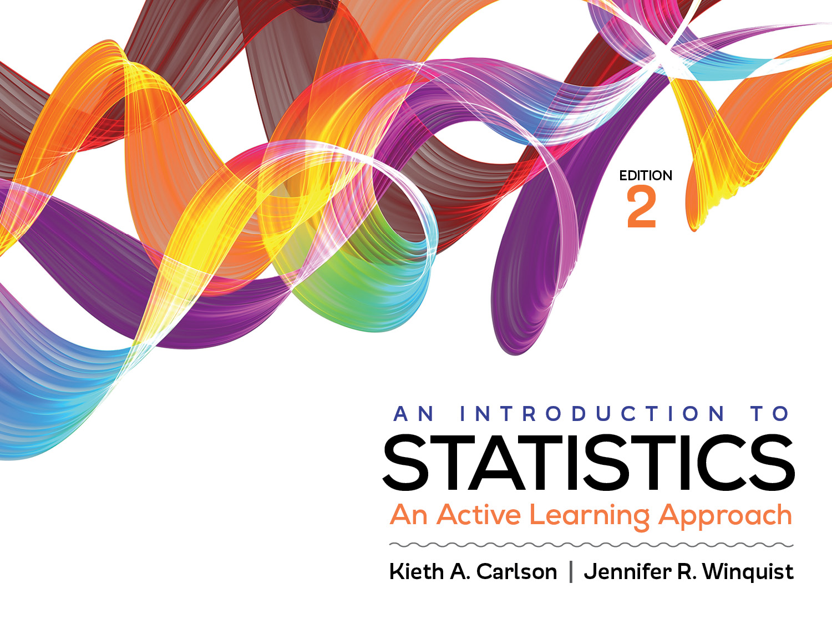
Introduction to Activity 13.5
Choosing the Correct Statistic

Slide 2
Activity 13.5 will require you to:
Choose the correct significance test for a given scenario
If necessary use Appendix J to help you

Slide 3
Which significance test and why?
Are depression scores of those who voted for the losing candidate in an election higher than those who voted for the winning candidate?
Are enjoyment scores of kids who go to Disneyland associated with the number of Disney movies those kids have seen?
Do socio-economic (i.e., below average, average, and above average) and political affiliation jointly influence attitudes on immigration?
Are socio-economic (i.e., far below average, below average, average, etc.) and religiosity ratings associated?
Are the movie ratings different for Democrats, Independents, and Republicans?

